Slide 1

Create a creative community destination hosted on the OKC website.
Goal 1
Gain a larger national following on all social media accounts.
Goal 2
Increase national prominence for the OKC Arts center.
Goal 3

Slide 2
Self-Paced Art Class – The OKC website will feature free convenient self paced, how to art videos. Each video features a discussion board where users can post, share, and receive feedback directly from OKC teachers and guest artists.
Paid Membership- To receive primary response for feedback to members discussion board posts. Paying members will also get early access to new self-paced videos before the rest of the public, allowing them to be the first to try new courses. Paying members will also be able to schedule 1 on 1 meetings with course instructors to receive more in-depth assistance.
Self-Paced Art Classes

Slide 3
Targeted Customer Segment: Active Young Aspiring Artists
Segment Description:
On the go daily
20-39
Creative
tech savvy
heavy social media use
Practices and learns on their own time
Seeking Convenience and Community
Is busy with other responsibilities but aspires to be an artist
Digital global overview report 2023, Datareportal.com:
Ages 20 to 29 are the largest users of social media making up 31% of worldwide users.
While 30 – 39 are the second largest group making up 22% of global users.

Slide 4
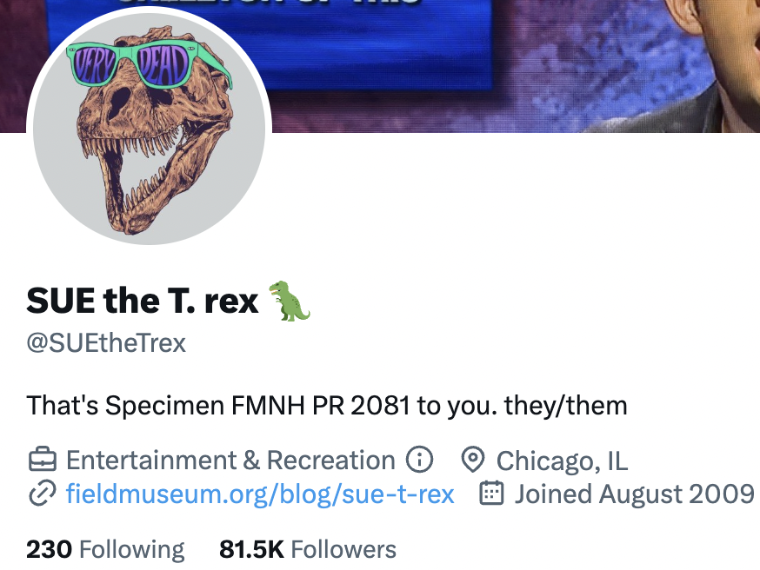
Strategies:
Social Media: OKC will launch a new series Self-Paced Art Classes on its existing YouTube page. As well as creating separate OKC Self-Paced Art Class’s Instagram, Facebook, and TikTok where video highlights and occasional art and performances will be posted in relation to the available courses. These social media sights are not only the most popular but also are the most used by the targeted customer segment.
A prime example of this separate social media tactic is Sue the T rex of the Field Museum. This separate page following the skeleton of a T rex has 81k followers and is a huge success at drawing attention for the museum.

Slide 5
Strategies:
Sponsors & Partners: Partnering with influencers, artists, and organizations nationwide for promotions and video creation. As well as partnering with businesses and organizations nationwide with large online followings who have similar values and/or would like to be associated with a creative program.
Funding: The OKC self-paced classes website section will allow for individual or organizational donations directly funding the Self-Paced class video production and website maintenance. This will allow for continued video production while opening a door for guests to later donate to the OKC as a whole.

Slide 6
1. To ensure consistent video creation and user engagement, OKC needs to post 100 videos in 3 years. This equates to posting at least 2 or 3 videos to the website a month.
2. Consistent growth and engagement of paying student members.
As the paying membership grows it will be necessary to add levels of membership at different costs which will dictate the priority of response to members posts. 1 on 1 meetings should always be reserved for the higher levels.
3. Reach 300,000 total followers including all social media accounts in three years.
followers and engagement of OKC posts should be tracked monthly and should consistently be positive in engagement.
Success Indicators:

Slide 7
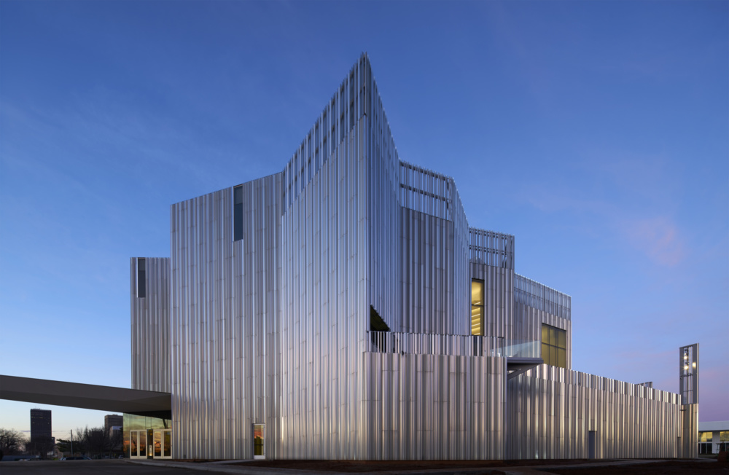
Thank You!

